Slide 1
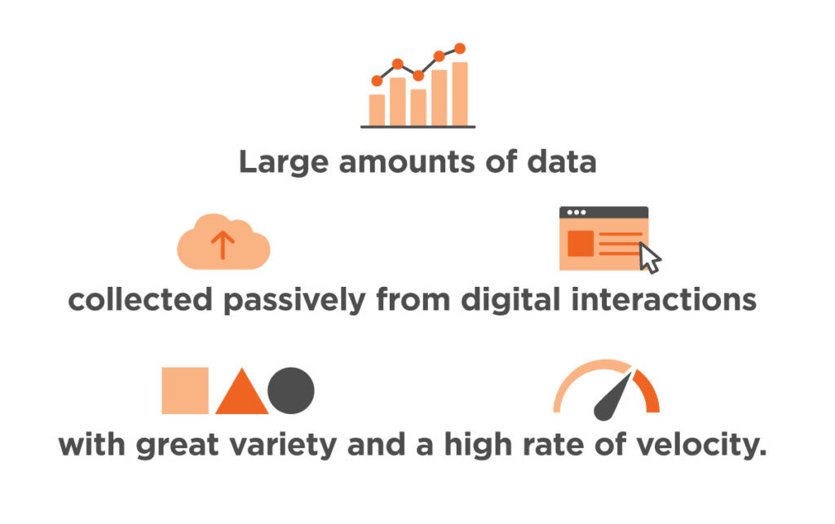
Big Data

Slide 2
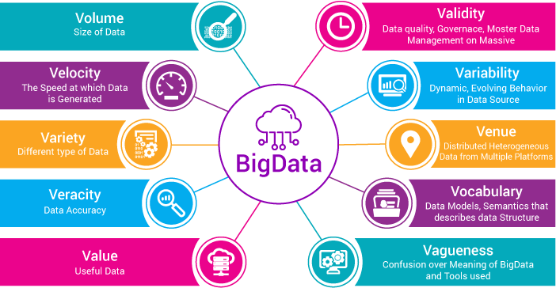
Characteristics of Big Data

Slide 3
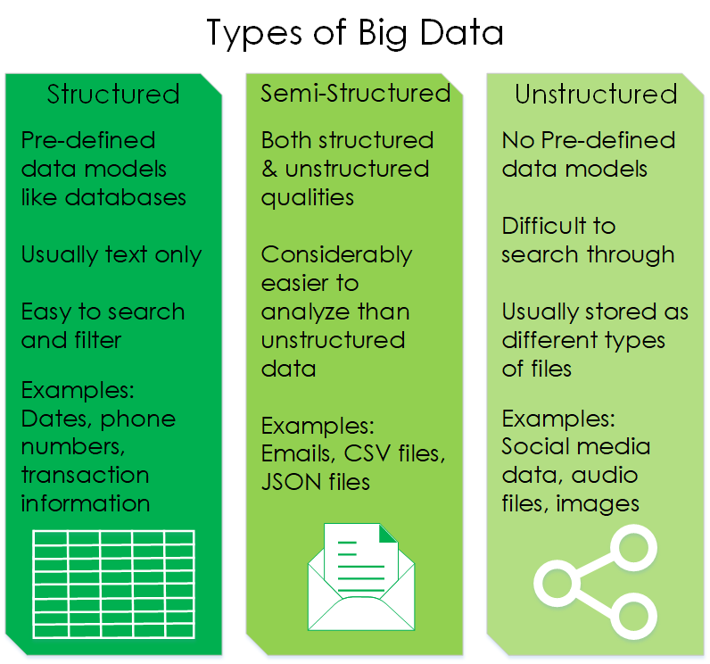

Slide 4
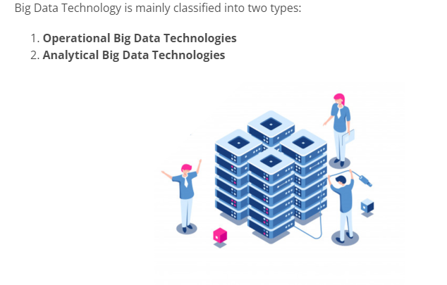
Types of Big Data Technologies

Slide 5
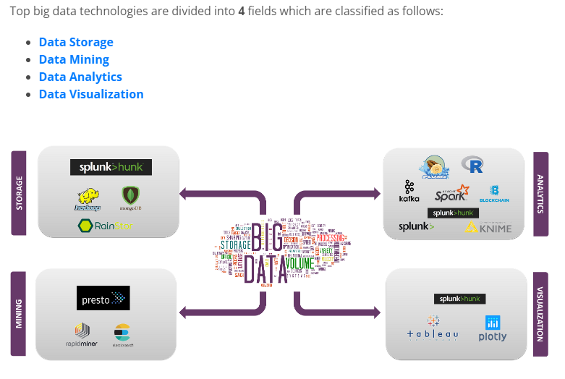
Top Big Data Technologies

Slide 6
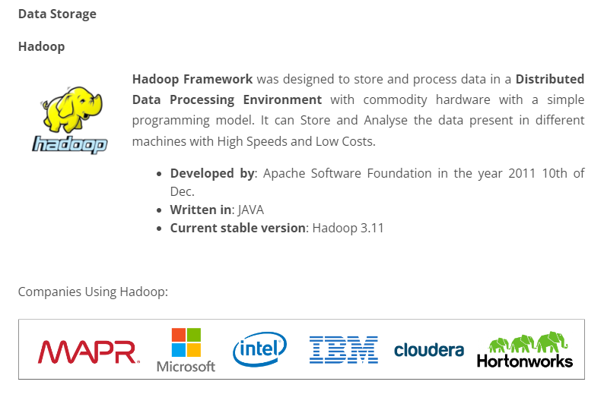

Slide 7
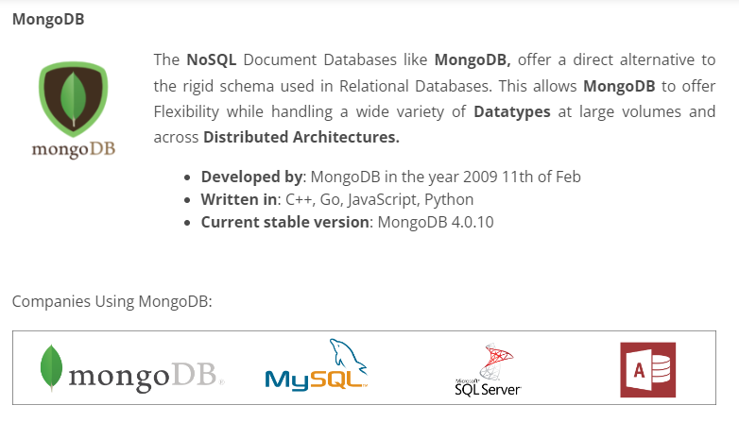

Slide 8
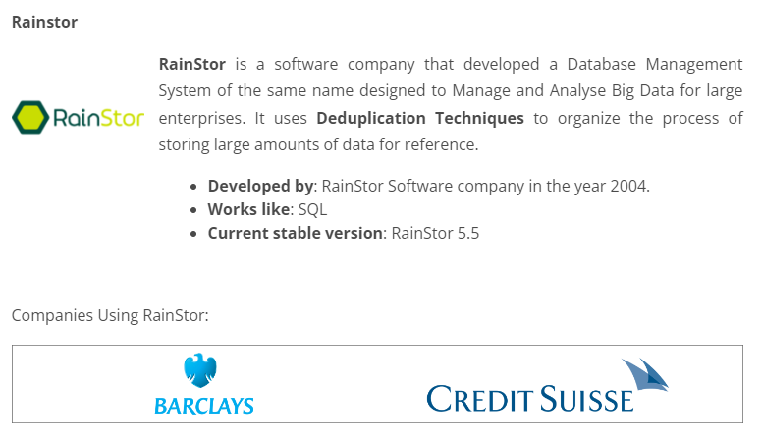

Slide 9
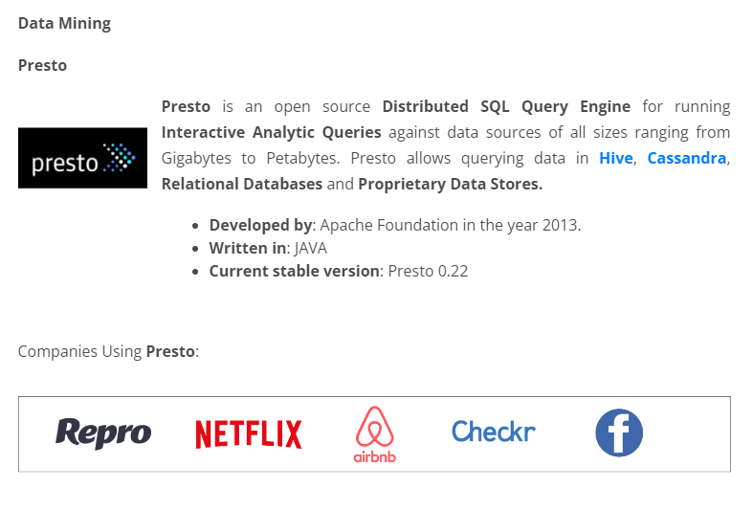

Slide 10
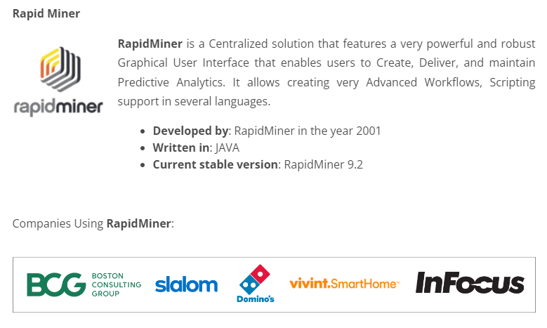

Slide 11
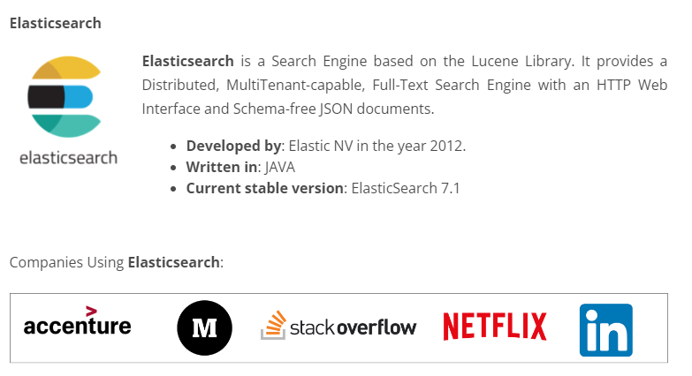

Slide 12
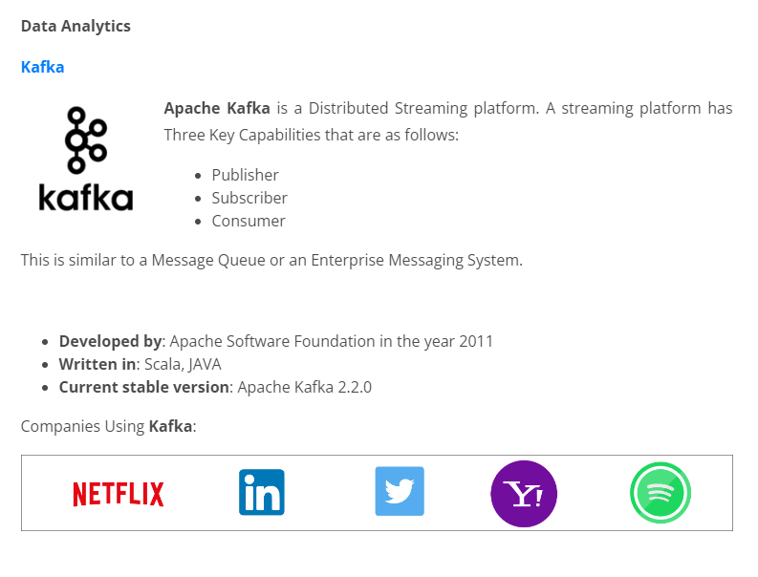

Slide 13
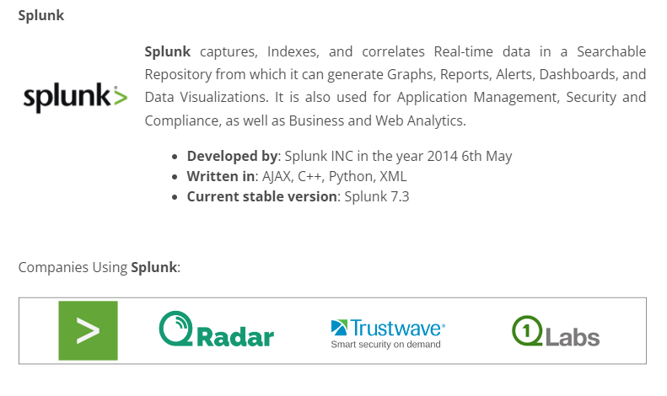

Slide 14
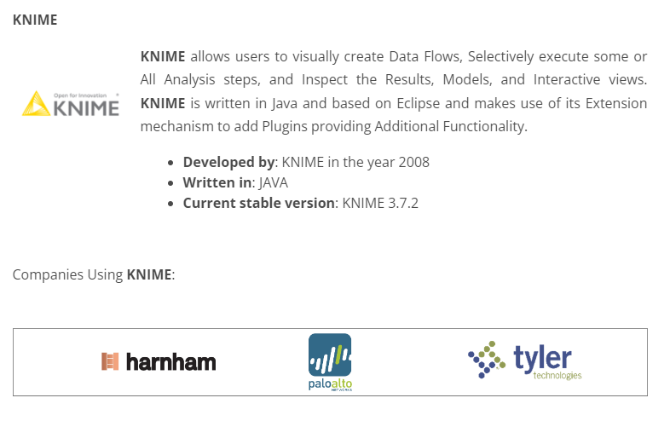

Slide 15
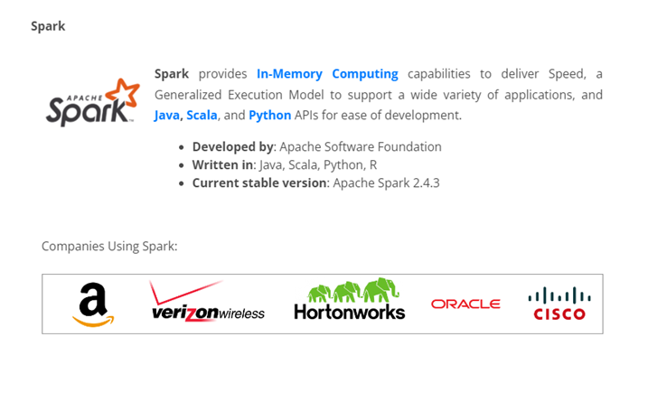

Slide 16
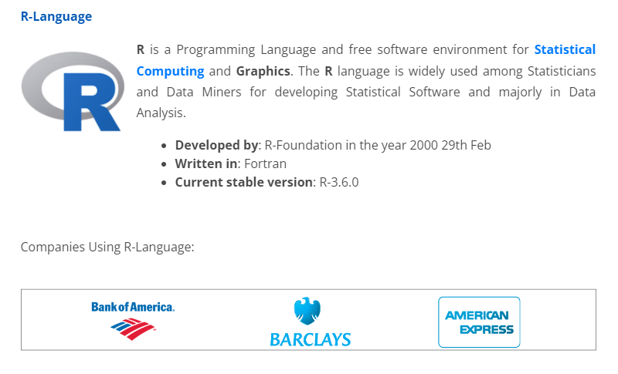

Slide 17
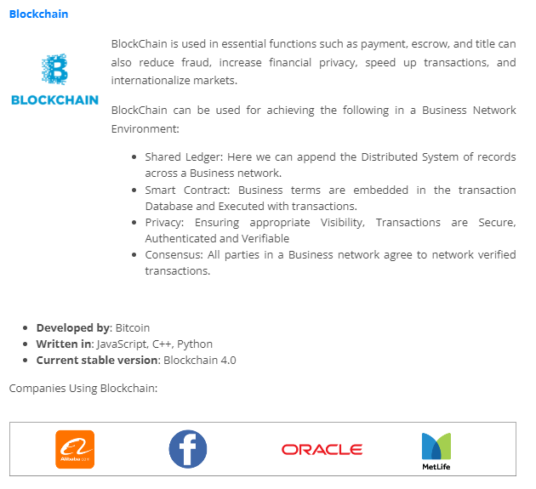

Slide 18
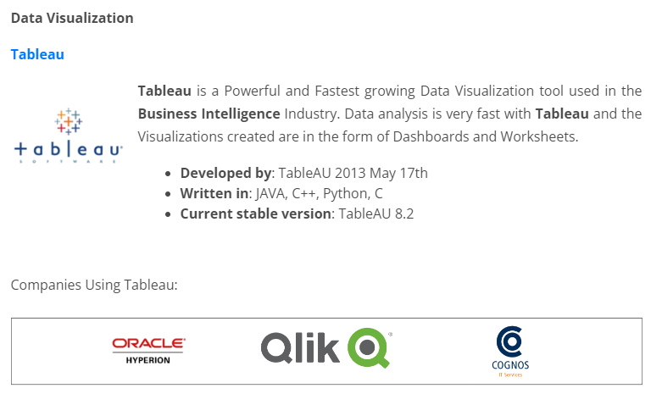

Slide 19
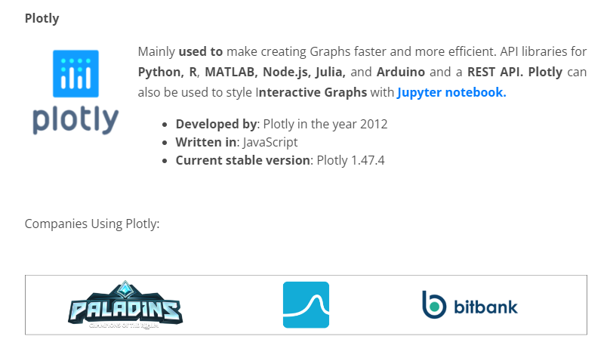

Slide 20
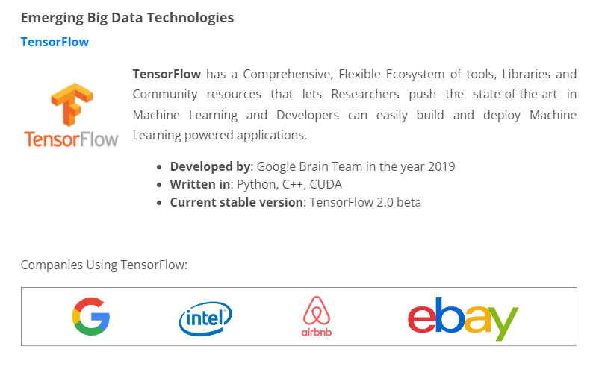

Slide 21
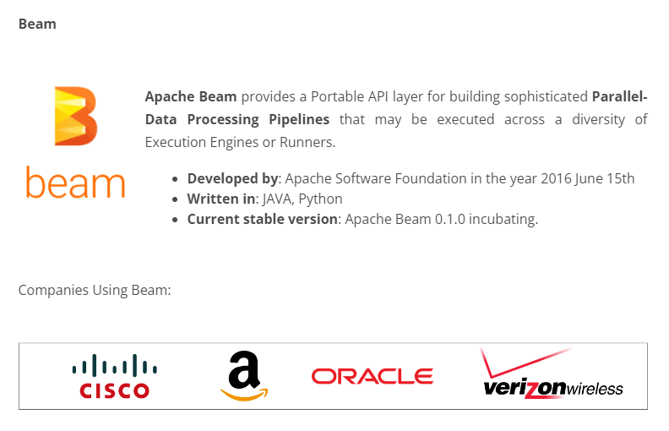

Slide 22


Slide 23
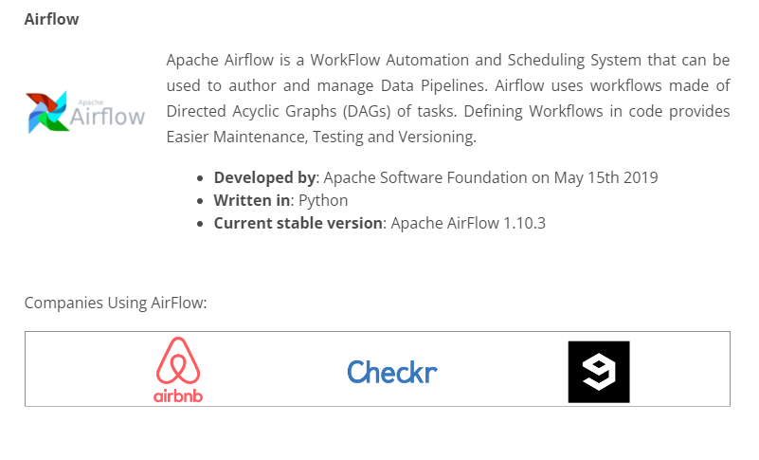

Slide 24
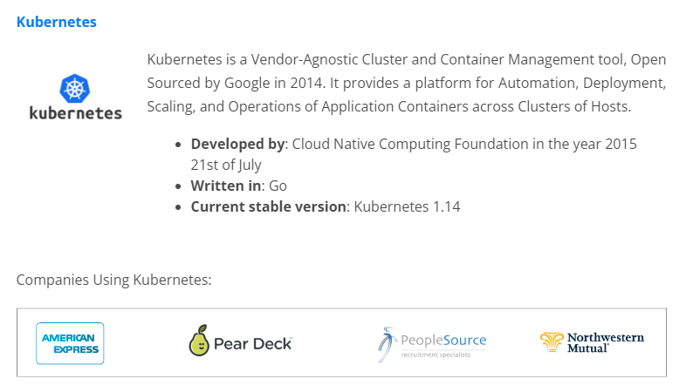

Slide 25
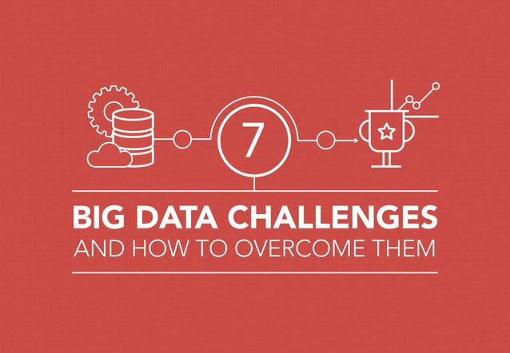

Slide 26
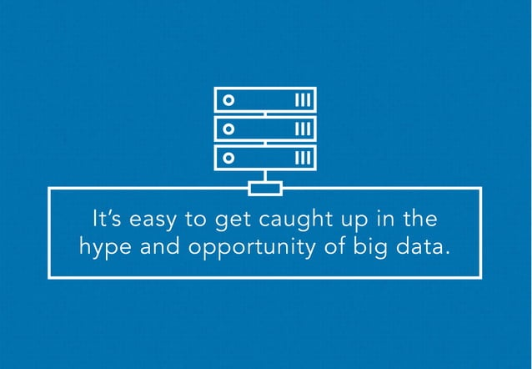

Slide 27
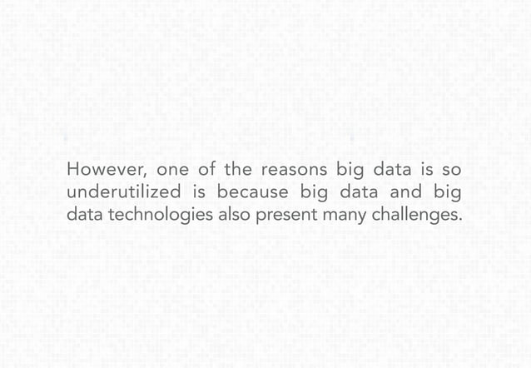

Slide 28
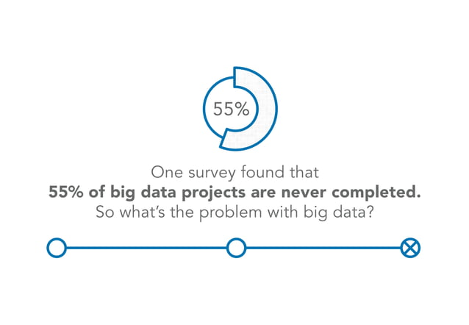

Slide 29
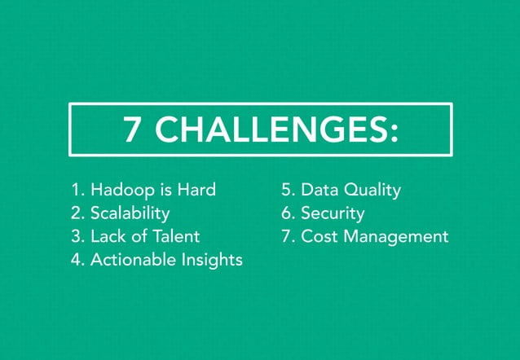

Slide 30
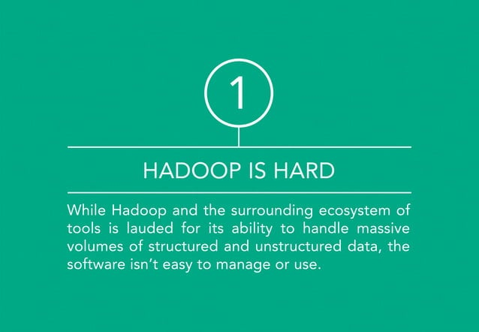

Slide 31
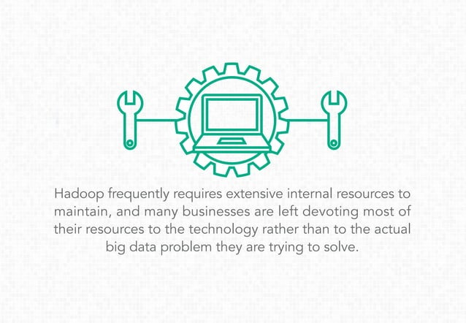

Slide 32
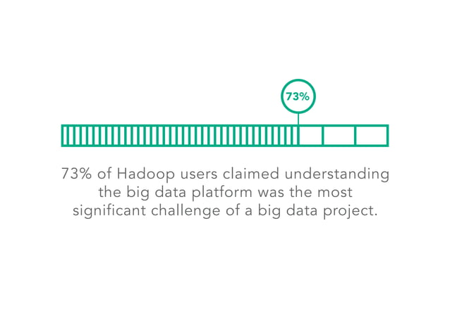

Slide 33
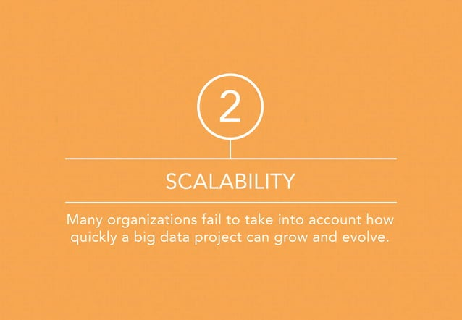

Slide 34
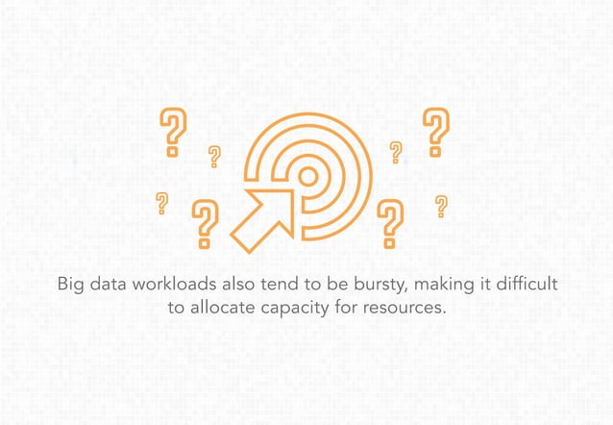

Slide 35
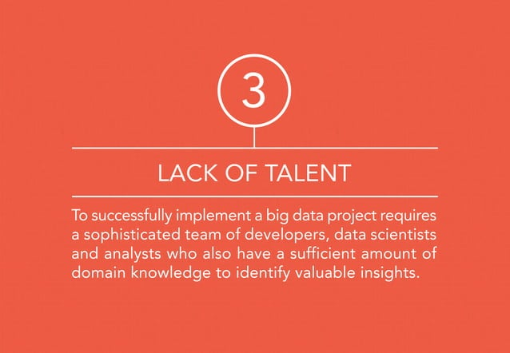

Slide 36
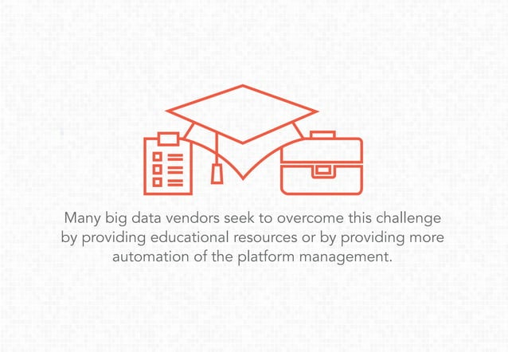

Slide 37
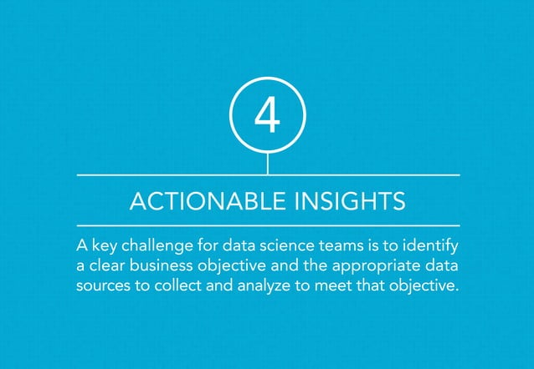

Slide 38
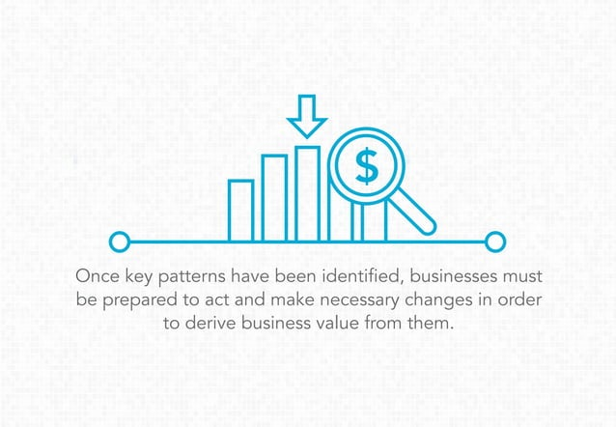

Slide 39
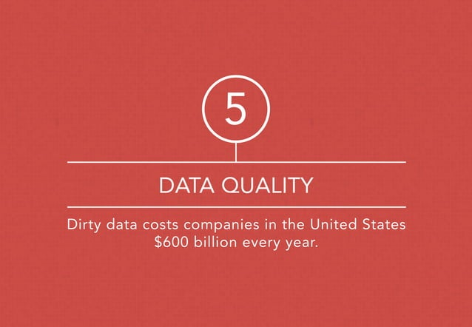

Slide 40
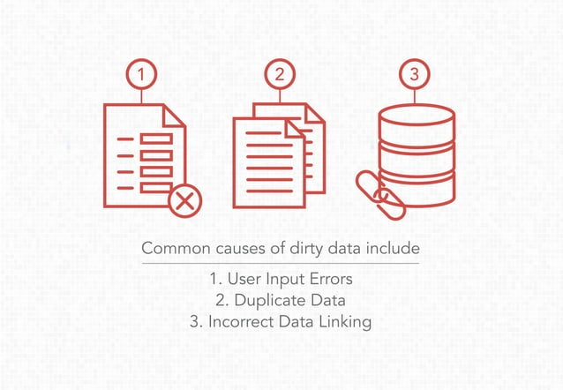

Slide 41
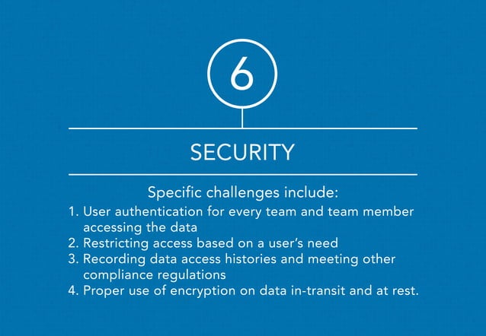

Slide 42
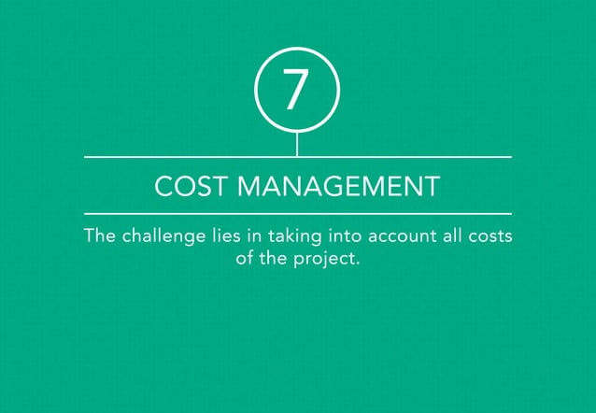

Slide 43
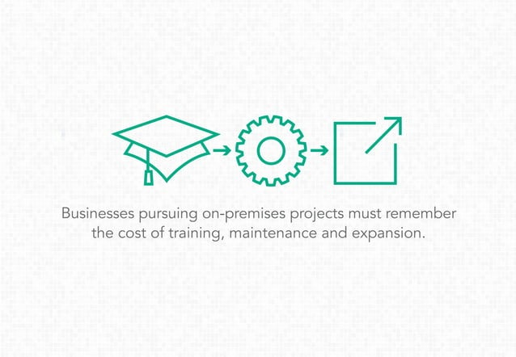

Slide 44
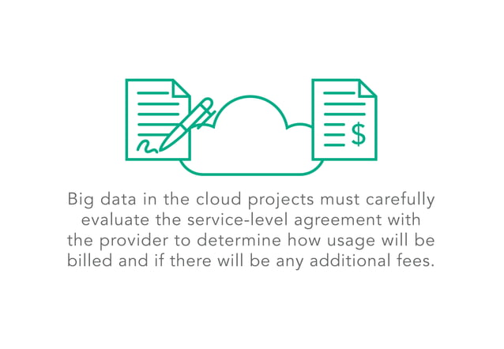

Slide 45
Current Researches in the Field of Big Data
Real-time big data processing: As more and more data is generated in real-time, researchers will focus on developing methods for processing and analyzing this data in near real-time.

Slide 46
Data governance: With the increasing amount of data being generated, researchers will focus on developing methods to govern and manage big data and ensure data quality, accuracy, and completeness.

Slide 47
Distributed computing for big data: With the increasing scale of data, researchers will focus on developing more efficient and effective distributed computing systems for big data processing and analysis.

Slide 48
Machine learning on big data: As the amount of data continues to grow, researchers will focus on developing more efficient and effective machine learning algorithms for big data.

Slide 49
Edge computing: With the increasing amount of data being generated at the edge of networks, researchers will focus on developing methods for processing and analyzing this data closer to the source.

Slide 50
Security and privacy: As big data becomes more prevalent, researchers will focus on developing methods to ensure the security and privacy of big data.

Slide 51
Explainability and interpretability: As big data becomes more prevalent, researchers will focus on developing methods to make the results of big data analysis more explainable and interpretable to users.

Slide 52
Quantum computing: As the potential to greatly accelerate certain types of data processing, particularly those that involve a lot of computational steps, such as machine learning and big data analysis. Because quantum computers use quantum bits (qubits) instead of classical bits, they can perform certain operations much faster than classical computers. However, it's still an emerging field, and it will take time before quantum computers are able to fully take advantage of big data. In the meantime, classical methods are still the primary means of analyzing big data.

Slide 53
Applications: Researchers will focus on developing new and innovative applications of big data in various domains such as IoT, healthcare, finance, manufacturing, and transportation.

Slide 54
Future Research Directions in the Field of Big Data
Advancing machine learning and AI techniques for data analysis.
Improving data privacy and security measures.
Developing new tools and infrastructure for handling big data.
Enhancing scalability and efficiency of big data processing.
Examining ethical and societal implications of big data and creating guidelines for responsible practices.
Combining and analyzing data from multiple sources for a comprehensive understanding.
Creating new applications for big data in various domains.
Developing real-time streaming analytics and processing.

Slide 55
Creating user-friendly data visualization tools.
Investigating the potential of quantum computing for big data processing.
Improving data quality control and preprocessing.
Examining the use of block chain technology for data storage and sharing.
Developing new methods for data visualization and exploration, which can help organizations to interact with and understand big data in new ways.
Developing new methods for data governance and management, which can help organizations to ensure that their big data sets are accurate, complete, and accessible.
Researching the use of time series analysis techniques for big data processing, which can help to identify patterns and trends over time.

Slide 56
Developing new methods for data auditing and compliance, which can help organizations to ensure that their big data sets meet legal and regulatory requirements.
Developing new methods for data quality assessment, which can help organizations to evaluate the quality of their big data sets.
Researching the use of GIS and spatial analysis techniques for big data processing, which can help to identify patterns and trends in geographic data.
Investigating the use of transfer learning algorithms for big data processing, which can help to improve the ability of machine learning models to generalize to new data.
Developing new methods for data storytelling, which can help organizations to communicate the insights and insights gained from big data in a clear and compelling way.
Investigating the use of generative adversarial networks (GANs) for big data processing, which can help to generate new synthetic data.

Slide 57
Investigating the use of natural language generation (NLG) techniques for big data processing, which can help to automatically generate human-like text from data.
Researching the use of Bayesian techniques for big data processing, which can help to incorporate prior knowledge and uncertainty into the analysis.
Developing data compression techniques.
Investigating the use of federated learning algorithms for big data processing, which can help to improve the privacy and security of big data sets.
Developing new methods for data lineage and provenance, which can help organizations to track the origin and history of their big data sets.
Investigating the use of active learning algorithms for big data processing, which can help to improve the accuracy of machine learning models over time.

